Slide 1
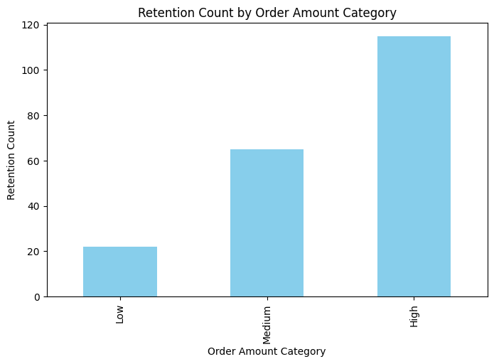
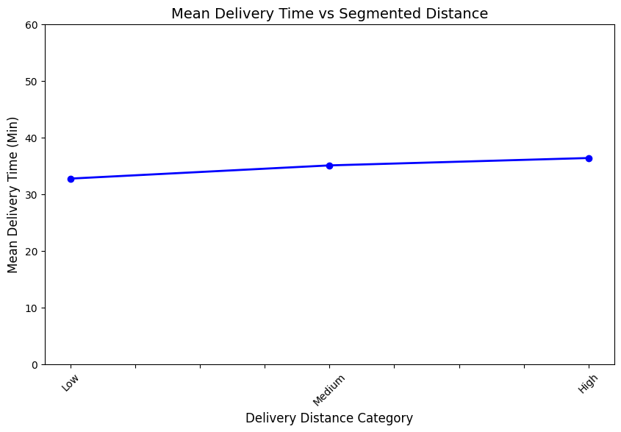
Optimizing QuickBites' Discount Strategy Using Data-Driven Insights
Approach:
1️⃣ Separate Analysis of 3 Datasets (No matching IDs to combine) 2️⃣ EDA (Exploratory Data Analysis) to understand distribution & trends 📊 3️⃣ Since correlation was weak, we used segmented data analysis to find meaningful patterns 🔍
📊 Dataset 1: Food Delivery Data (Key Insights)
🔹 Delivery time remains almost the same
for both near and far-away distances. 🔹 Customer retention increases with
higher purchase values
🔹 Customer who live far away tend to order
more
📉 Supporting Visuals:
🖼️ Graph 1: Mean Delivery Time across Distance Categories
🖼️ Graph 2: Retention Rate based
on Order Value

Slide 2
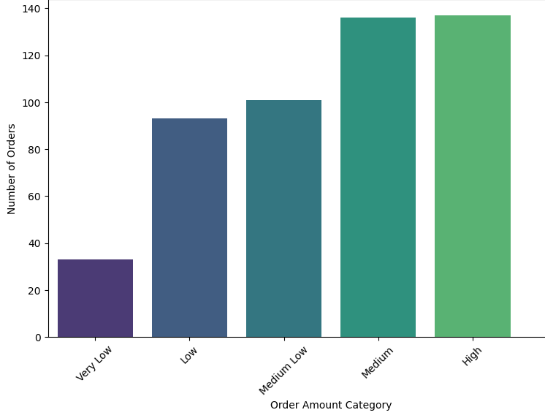
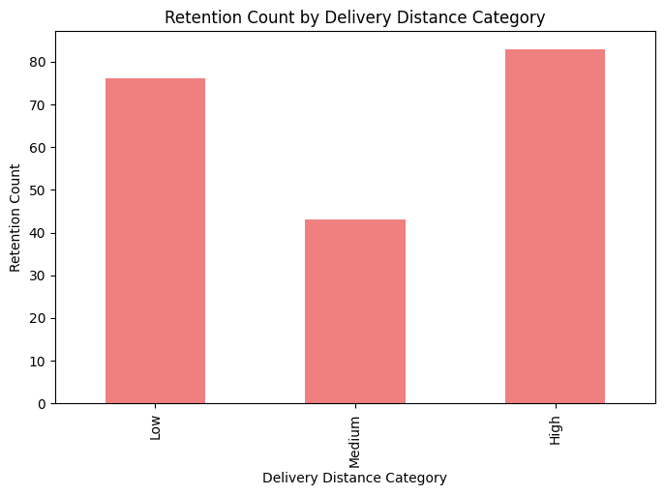
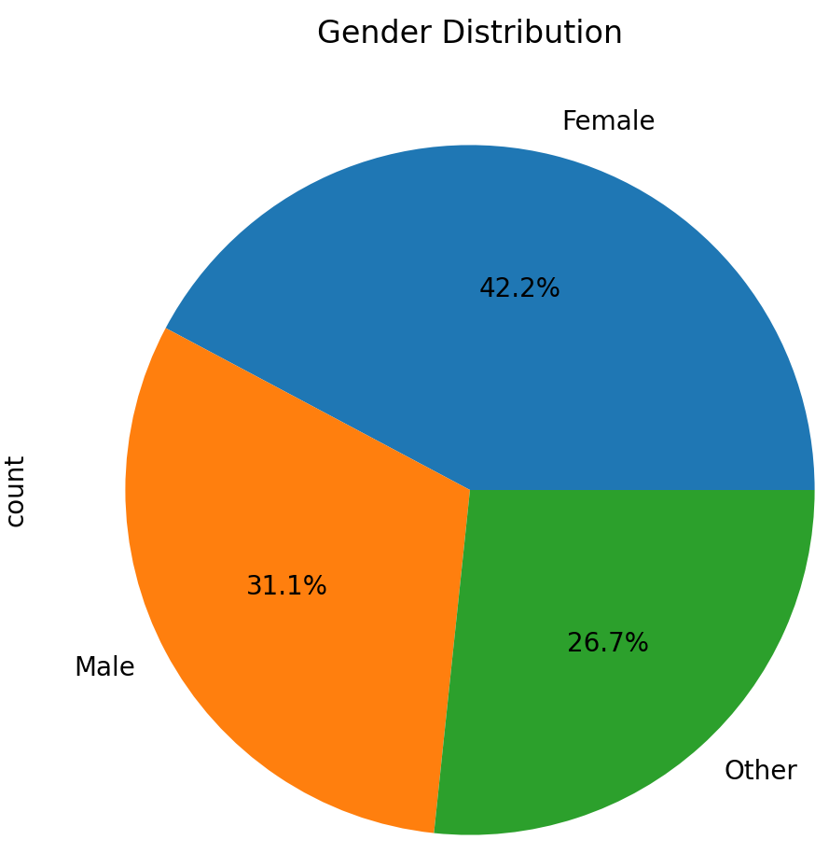
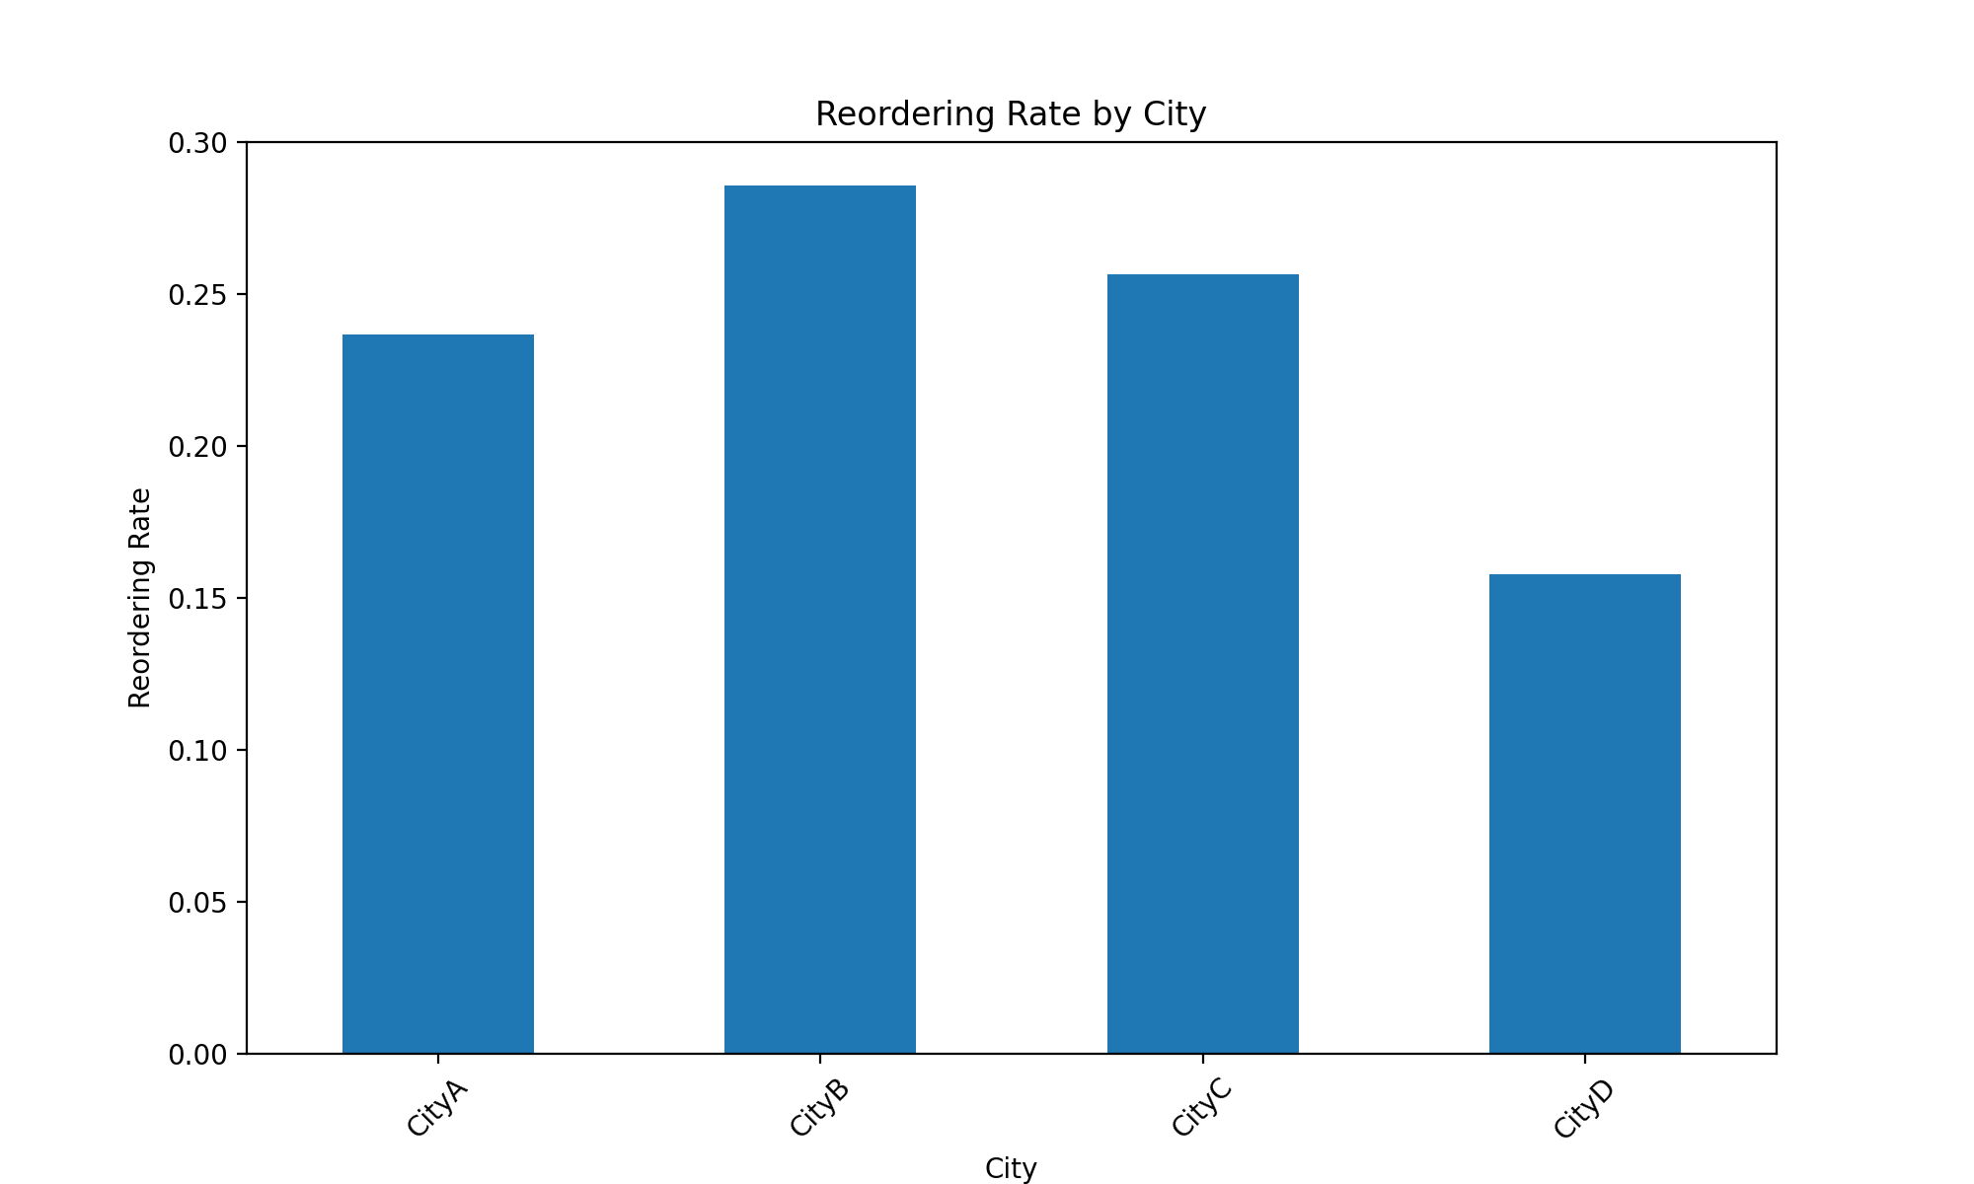
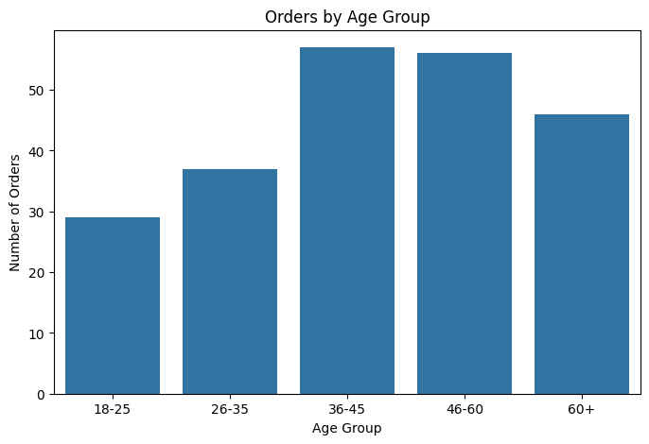
Additional Insights on Data Set 1
Business Implications & Solutions
1️⃣ Increase discounts for nearby customers 🔹 Customers living nearby currently receive no additional incentive since delivery time is slow. To attract and engage them, introduce targeted discounts for low-value orders in nearby locations.
2️⃣ Optimize discount distribution to maximize profitability 🔹 High-purchase customers are already loyal, so discounts can be slightly reduced for them while increasing them for mid-value customers. This will help in expanding the customer base without significantly affecting revenue
.
3️⃣ Introduce personalized promotions based on location & order value 🔹 Use segmented analysis to provide location-based offers
1.Number of orders vs Order
Amount Categories(very low- High)
2.Retention Count bs Delivery
Distance Categories (Low-High)
📊 Dataset 2: Food Delivery Data (Key Visuals)

Slide 3
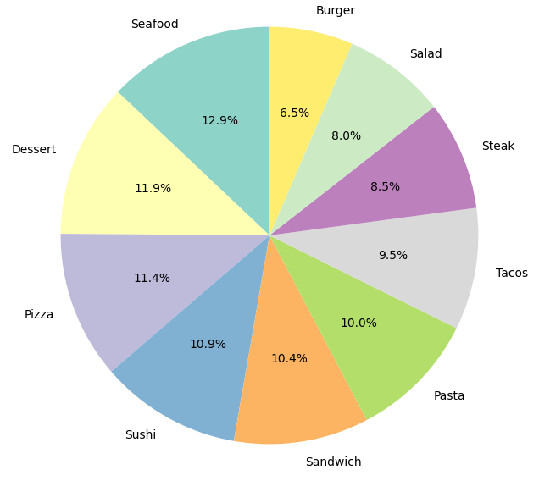
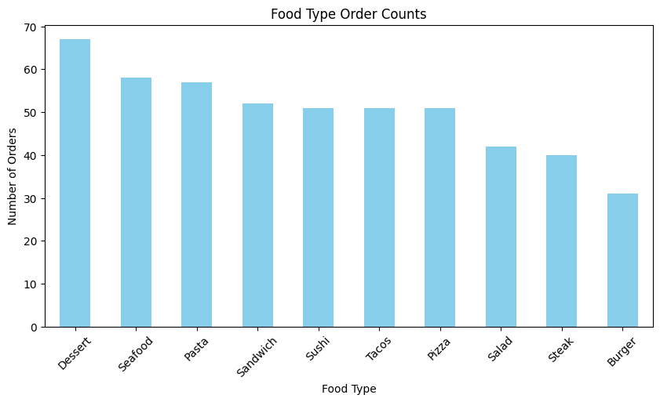
Key Insights For Data set 2
Solutions as per Data Set 2
1️⃣ Age Group: 35-60 has the highest ordering & repeat rate, while 18-25 has the lowest. 2️⃣ Gender: Females have the highest ordering & repeat rate. 3️⃣ City: City B & C have the highest orders & repeat rate, while City D is the lowest in both.
🔹Offer targeted discounts & loyalty rewards for 18-25 to increase both orders and retention, as younger customers generally have a larger market share.
🔹Since females likely order for families, offer free home essentials to attract more female users and discounts for males to balance engagement.
🔹Investigate City D’s low engagement and introduce location-based incentives to drive both new and repeat customers.
Key Insights For Data set 3
1️⃣ Seafood, Dessert, and Pizza are the most reordered food items by repeat customers.
2️⃣ Fridays and Saturdays have the highest orders, while Mondays and Tuesdays have the lowest.
2️⃣ 80% of customers order only once, while 20% are repeat customers who contribute significantly to sales.
Solutions as per Data Set 3
🔹 Introduce loyalty rewards (buy 5, get 1 free) for repeat customers ordering Seafood, Dessert, and Pizza.
🔹 Run Monday-Tuesday flash sales (20% off) and combo deals to increase sales on slow days.
🔹 Launch a referral program (₹50 off for both referrer and referee) to attract new customers.

